Slide 1
YOUR CONNECTIVITY PARTNER

Slide 2
… since 2003 …
Headquarters
Brembate di Sopra, Bergamo,
Italy.
Stock of 8 million pcs.
Branches
Production
Rockaway, NJ, Usa.
Stock available.
Taipei, Taiwan.
Stock available.
Dongguan, China.
Stock available.

Slide 3
HTP products are sold to first class customers
North America
Europe
Asia
Africa
South America
Australia
… since 2003 …
… in over 70 countries …
… in all continents …

Slide 4
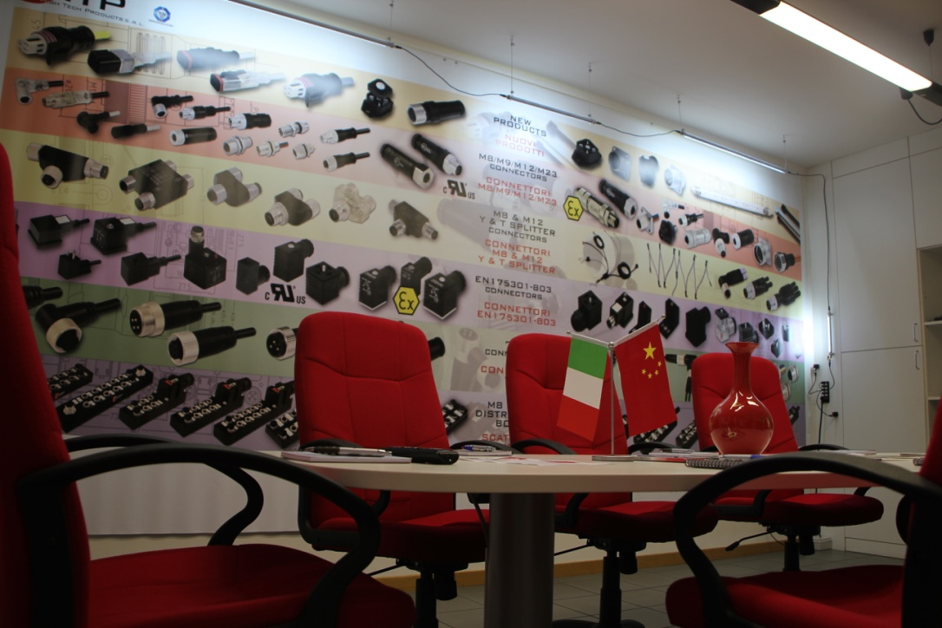
Benefits for the customers
Very high quality
Complete and very wide range of products
Product range continuously increasing through R&D focused on new key products
The most competitive prices in the market
Just in time delivery from our stock in Italy, USA, China and Taiwan
Innovative, unique and cost effective technical solutions and features of our products
Brand labelling and development of special products
Ability to find and implement most suitable technical and commercial solutions to any customers’ requirements

Slide 5
c/UL APPROVED
Issued to:
HTP SRL
VIA Lesina, 45
24030-BREMBATE DI SOPRA-BG
ITALY
CONNECTORS FOR USE IN DATA, SIGNAL, CONTROL AND POWER
This is to certify that representative samples of
Series Housing G1/G2/P1/P2/M1/M2/BM and Header BG & BP.
M8 / M12 MOULDED CABLE VERSIONS
Have been investigated by Underwriters Laboratories in accordance with the Standard(s) indicated on this Certificate.
Standard(s) for Safety:
UL 1977 - Component Connectors for Use in Data, Signal, Control and Power Applications CAN/CSA C22.2 No. 182.3-M1987 – Special Use
Attachment Plugs, Receptacles and Connectors
Additional Information:
See UL On-line Certification Directory at WWW.UL.COM/database for additional information.

Slide 6
ATEX 94/9/CE APPROVED
General information
- Report n°: 13/2062-AET 1162
- Date of report: 30.10.2013
- Prepared by: Ing. Giuseppe Terzaghi, CEC – consorzio europeo certificazione S.C.A.R.L.
- Main reference norm: ATEX 94/9/CE
- Equipment under test: connectors for electric valves
- Manufacturer: HTP S.r.l.
- Applicant’s name and address: HTP S.r.l. - Via Lesina, 45
24030 – Brembate di Sopra (BG) - Italy
Type: DIN 43650 – A (G1+G2), DIN 43650 – B (M1+M2),
DIN 43650 – C (P1+P2), M8 field attachable 3/4 poles
M12 field attachable 3/4/5/8/12 poles

Slide 7
Certification UNI EN ISO 9001:2008

Slide 8
M8/M9/M12/M23 CIRCULAR CONNECTORS
M8//M9/M12/M23 circular connectors are normally used with
sensors and can also be used to implement a flexible I/O or
field bus connection on the circuit board
With the modular design concept, connectors are available
in different versions, e.g.: 2-, 3-, 4-, 5-, 8-, 12- pin for M12
connectors, as well as 3- and 4-pin for M8 connectors
M12 connectors are currently recommended as field bus
connectors for almost all field bus specifications, and are
also available with different coding (A, B, D)
M8/M12/M23 circular connectors are available as field
attachable, moulded assembly and panel mounting

Slide 9
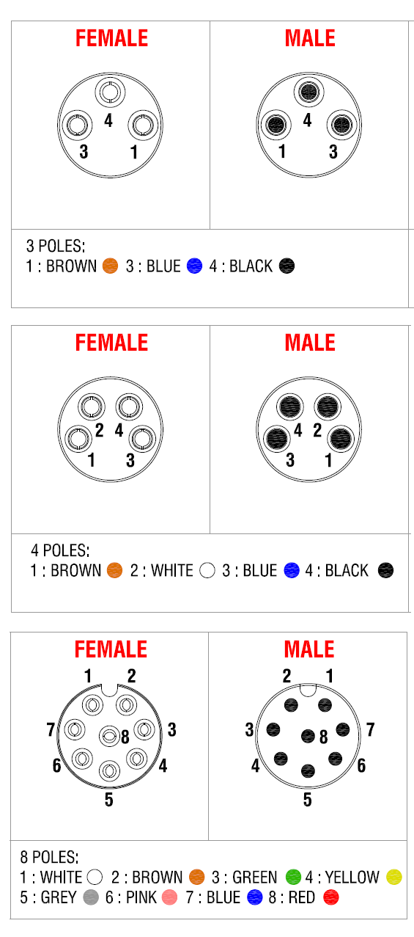
M8/M9/M12/M23 CIRCULAR CONNECTORS

Slide 10
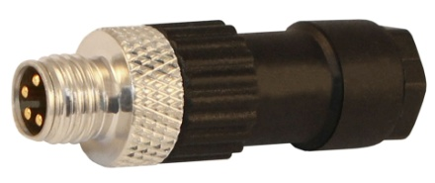
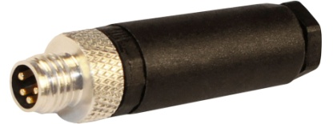
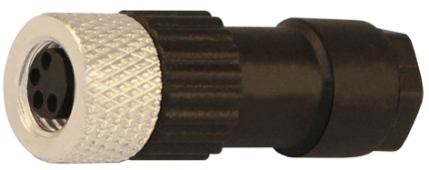
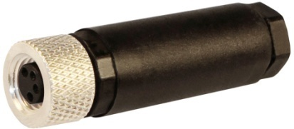
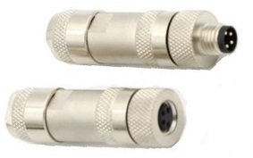
M8 field attachable connectors
M8/M9/M12/M23 CIRCULAR CONNECTORS
3 and 4 poles
Male and female
Solder contacts and screw contacts
METAL VERSION
To Solder
To Screw
METAL
*Also available with stainless steel nut

Slide 11
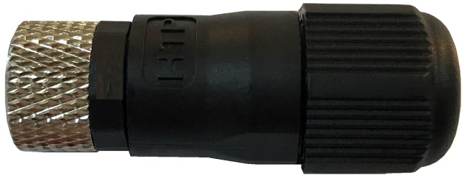
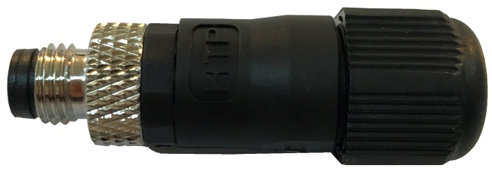
M8 field attachable connectors
M8/M9/M12/M23 CIRCULAR CONNECTORS
3 and 4 poles sk versions with cable entry from 3,5mm to 6mm
Male and female
Solder contacts and screw contacts
To Solder
To Screw
*Also available with stainless steel nut

Slide 12
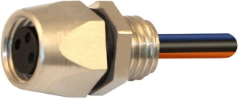
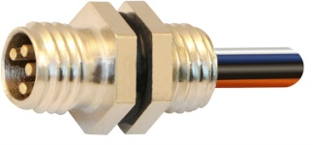
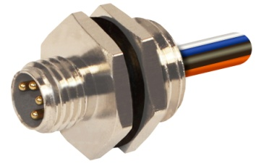
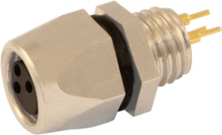
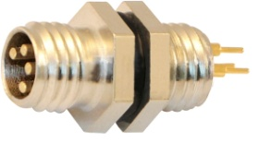
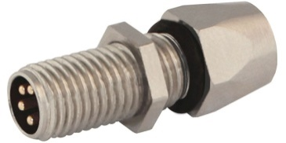
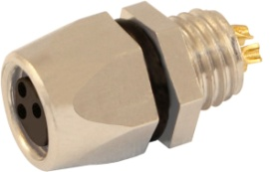
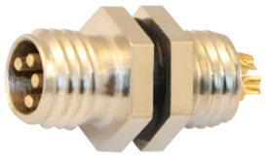
M8 panel mounting connectors
M8/M9/M12/M23 CIRCULAR CONNECTORS
3 and 4 poles
Male and female
Front and back mounting
With soldered contacts, PCB contacts and with wire already
soldered
with M12 thread
Adapter Male/Female
*Also available with stainless steel nut

Slide 13
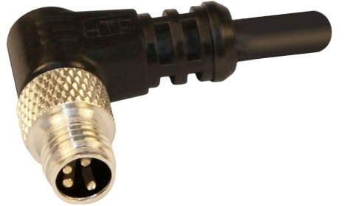
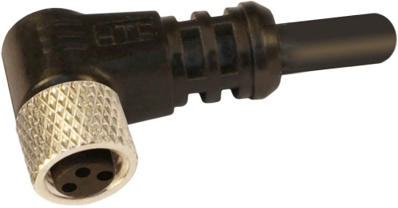
M8 connectors with moulded cable
M8/M9/M12/M23 CIRCULAR CONNECTORS
3 and 4 poles and 8 POLES
Male and female
Straight and right angled
Single and double ended
PVC, PUR cable, shielded and fully shielded
Any length avaiable
90°
Straight
*Also available with stainless steel nut

Slide 14
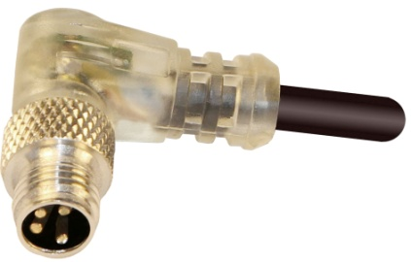
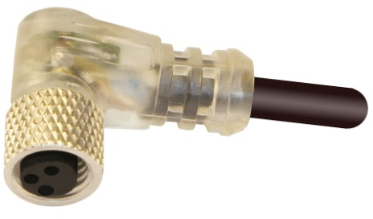
M8 connectors with PNP Led and moulded cable
M8/M9/M12/M23 CIRCULAR CONNECTORS
3 and 4 poles
Male and female
Straight and right angled
Single and double ended
PVC and PUR cable
Any length avaiable
2 LED’s for PNP and NPN switch indication
90°
Straight
*Also available with stainless steel nut

Slide 15
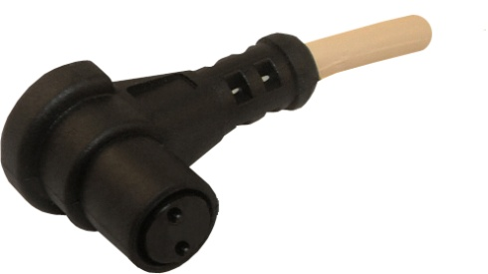
M8 snap connectors with PNP or PUR moulded cable
M8/M9/M12/M23 CIRCULAR CONNECTORS
2, 3 and 4 poles
Female / MALE
Straight and right angled
PVC and PUR cable
Any length avaiable
Straight
90°

Slide 16
Extensions M8 with cable
M8/M9/M12/M23 CIRCULAR CONNECTORS
3, 4 poles AND 8 POLES
Male and female
PVC, PUR, moulded and shielded cable
Operating voltage: 60V AC/DC
Operating current: 4A
Maximum conductor size: 0,25 mm2
Protection class (IEC 60529): IP 69K
Temperature range: -25°C to +70°C
90°
Straight
*Also available with stainless steel nut

Slide 17
M8/M9/M12/M23 CIRCULAR CONNECTORS
M9 with cable
5 poles versions
Male and female
PUR shielded cable
totally shielded connectors with PUR shielded cable
Straight

Slide 18
M9 totally shielded connectors with PVC or PUR shielded cable
M8/M9/M12/M23 CIRCULAR CONNECTORS
5 poles
Male and female
PUR shielded cable and totally shielded connectors with
PUR shielded cable
Operating voltage: 30V AC/DC
Operating current: 3A
Maximum conductor size: 0,25 mm2
Protection class (IEC 60529): IP 69K
Temperature range: -25°C to +70°C
Female
Male

Slide 19
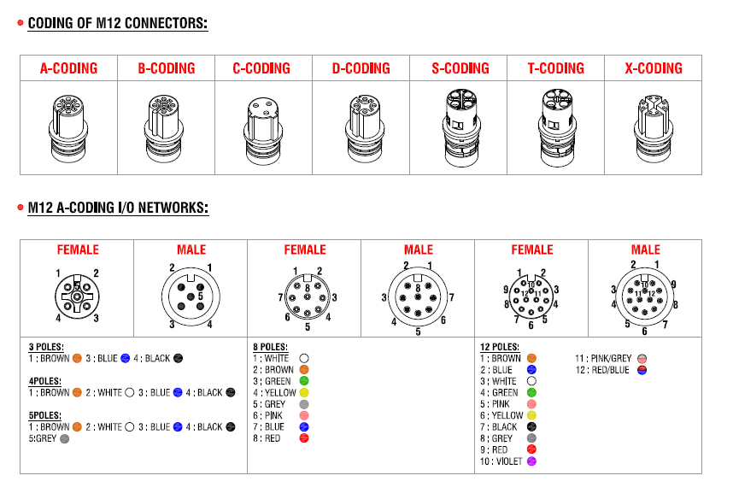
M8/M9/M12/M23 CIRCULAR CONNECTORS
M12 circular connectors

Slide 20
M8/M9/M12/M23 CIRCULAR CONNECTORS
M12 field attachable circular connectors
4, 5, 8, 12 poles versions
Male and female
Screw terminals (4,5,8 poles)
Solder terminal (12 poles)
Straight and right angle
PG7, PG9/PG11 and New version with from 4mm to 9mm cable exit.
Single and dual cable entry

Slide 21
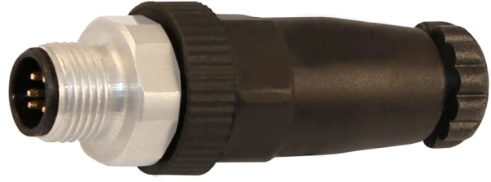
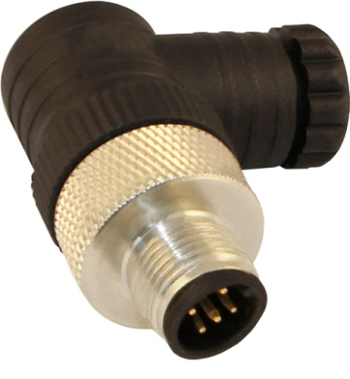
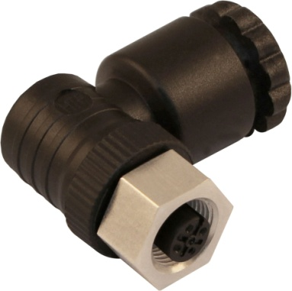
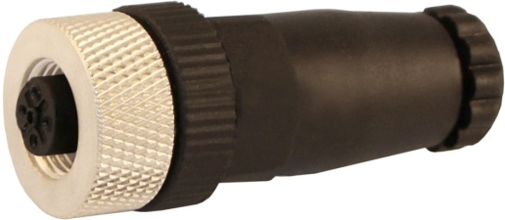
M8/M9/M12/M23 CIRCULAR CONNECTORS
with hexagonal stainless-steel nut

Slide 22
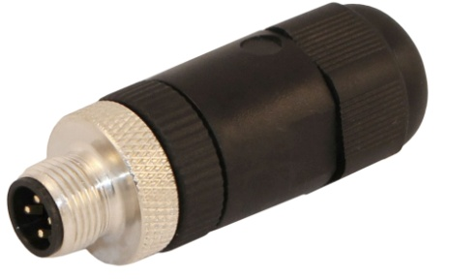
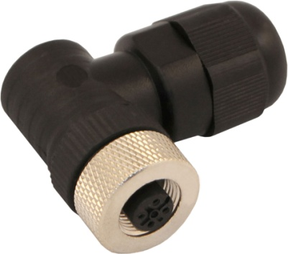
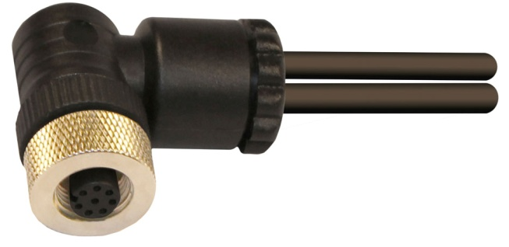
M8/M9/M12/M23 CIRCULAR CONNECTORS
*Also available with stainless steel nut

Slide 23
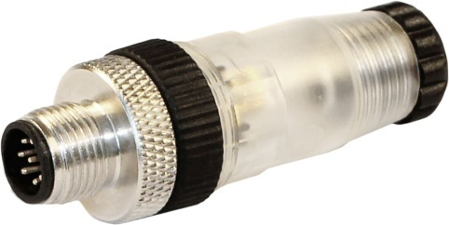
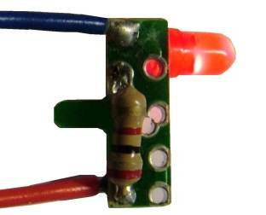
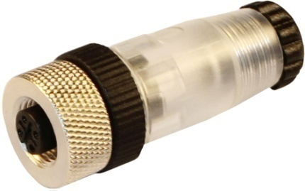
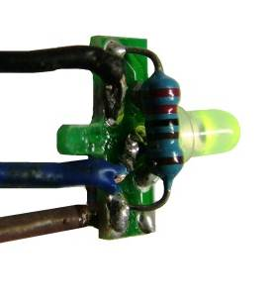
M12 field attachable transparent connectors
M8/M9/M12/M23 CIRCULAR CONNECTORS
4 and 5 poles
Male and female
Screw terminals
Straight and right angled
Also available 2 kinds of circuits
with 1 LED and with bi-colour LED
*Also available with stainless steel nut

Slide 24
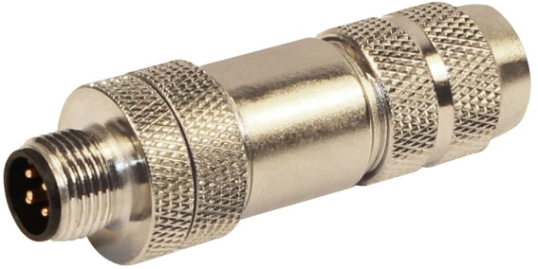
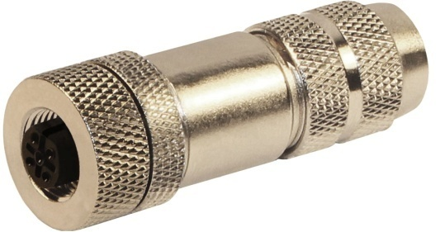
M12 field attachable connectors with metal housing
M8/M9/M12/M23 CIRCULAR CONNECTORS
4, 5, 8, 12 poles
Male and female
Housing in nickel plated brass
For tough environments
Rated IP 67
Completely shielded
A, B, D Coded
*Also available with stainless steel nut

Slide 25
M8/M9/M12/M23 CIRCULAR CONNECTORS
M12 panel mounting connectors
4, 5, 8, 12 poles
Male and female
Front and back mounting
Solder and PCB connections and pre-wired

Slide 26
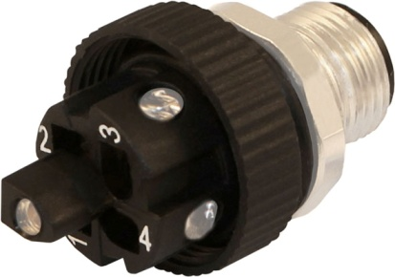
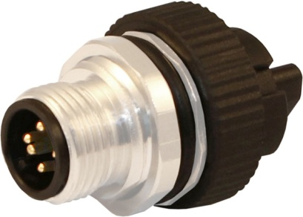
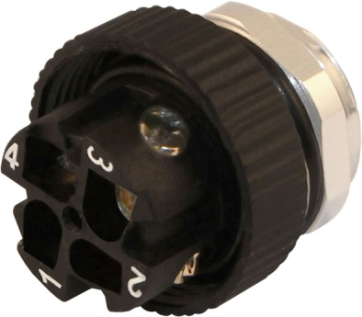
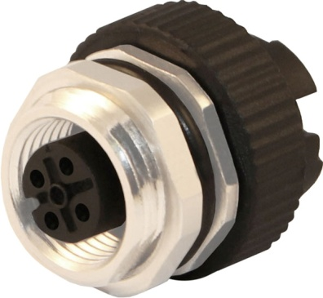
M8/M9/M12/M23 CIRCULAR CONNECTORS
M12 panel mounting connectors
M12 panel back mounting connectors
With screw contacts
male
female
*Also available with stainless steel nut

Slide 27
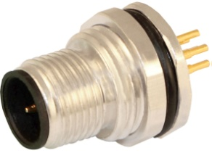
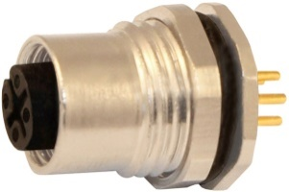
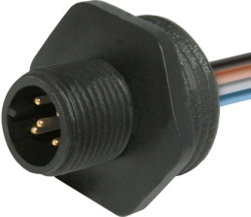
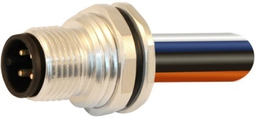
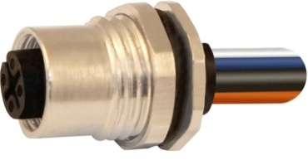
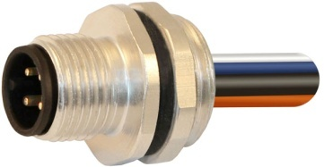
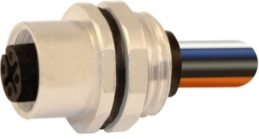
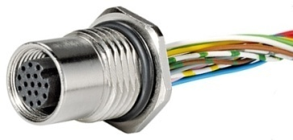
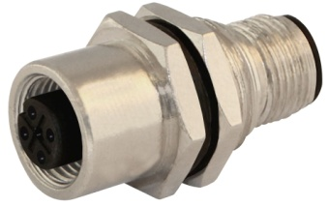
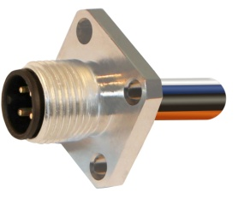
M12 panel mounting connectors
M8/M9/M12/M23 CIRCULAR CONNECTORS
Male
Female
Back Mounting
Plastic Housing
Front Mounting
17 poles
Adapter Male/Female
With flange
*Also available with stainless steel nut

Slide 28
M12 connectors with PVC or PUR moulded cable
M8/M9/M12/M23 CIRCULAR CONNECTORS
4,5,8 and 12 poles
Male and female
Straight and right angled
PVC and PUR cable
Any length avaiable
90°
Straight
*Also available with stainless steel nut

Slide 29
M12 totally shielded connectors with shielded cable
M8/M9/M12/M23 CIRCULAR CONNECTORS
3, 4, 5, 8, 12 poles
Male and female
Straight and right angled
Shield connected to the nut and/or to the 5^{th /} 8th pin
Single and double ended
PVC and PUR shielded cables
90°
Straight
*Also available with stainless steel nut

Slide 30
M12 moulded connectors with Led
M8/M9/M12/M23 CIRCULAR CONNECTORS
3, 4, 5 poles
Male and female
Straight and right angled
Single and double ended
PVC and PUR cable (other cable available on request)
Any length available
2 and 3 LED’s for PNP and NPN switch indication
*Also available with stainless steel nut

Slide 31
M8/M9/M12/M23 CIRCULAR CONNECTORS
M12 T and Y splitters
“T” and “Y” splitters are designed to expand the ports on hard wired distribution boxes, by splitting the two individual wires into two connectors
Also fully shielded available
NEW – Transparent “Y” with light indication

Slide 32
M12 T and Y-splitter connector
M8/M9/M12/M23 CIRCULAR CONNECTORS
M12 T connectors,
360° totally shielded
*Also available with stainless steel nut

Slide 33
M12 Moulded Y Splitters
M8/M9/M12/M23 CIRCULAR CONNECTORS
3, 4, 5, 8 and 12 poles
Male and female
2 and 3 way
Straight and angled
*Also available with stainless steel nut

Slide 34
Extensions cables
M8/M9/M12/M23 CIRCULAR CONNECTORS
M8/M12 to M8/M12
3, 4, 5, 8, 12 poles
Male and female
PVC, PUR and Shielded cable (other cable available on request)
Any length available
Fully shielded version available
*Also available with stainless steel nut

Slide 35
M12 field attachable connectors B-coded (PROFIBUS)
M8/M9/M12/M23 CIRCULAR CONNECTORS
4 and 5 poles
Male and female
With plastic and metal housing
Straight and right angled with plastic
M12 Panel Mounting
*Also available with stainless steel nut

Slide 36
M12 B-coded terminal connectors (PORFIBUS)
M8/M9/M12/M23 CIRCULAR CONNECTORS
5 poles
Male and female
With terminal connectors and totally shielded
Totally shielded
Terminal connectors
*Also available with stainless steel nut

Slide 37
M12 T and Y-splitter connector (PROFIBUS)
M8/M9/M12/M23 CIRCULAR CONNECTORS
*Also available with stainless steel nut

Slide 38
M12 field attachable connectors D-coded
M8/M9/M12/M23 CIRCULAR CONNECTORS
5 poles
Male and female
Straight with plastic and metal housing
Angled with plastic and metal housing
*Also available with stainless steel nut

Slide 39
ATEX 94/9/CE approved
M8-M12 CIRCULAR CONNECTORS
FIELD ATTACHABLE

Slide 40
M12 panel mounting connectors D-coded
M8/M9/M12/M23 CIRCULAR CONNECTORS
4 poles
female
Back panel Mounting
PG9 with DOUBLE CUT
*Also available with stainless steel nut

Slide 41
M12 field attachable connectors C-coded
M8/M9/M12/M23 CIRCULAR CONNECTORS
3 poles
Male and female
Straight with plastic and metal housing
Angled with plastic and metal housing
M12 Panel Mounting
*Also available with stainless steel nut

Slide 42
M12 field attachable connectors S-coded
M8/M9/M12/M23 CIRCULAR CONNECTORS
4 poles
Male and female
Straight with plastic and metal housing
Angled with plastic and metal housing
M12 Panel Mounting
RATED VOLTAGE:630V AC/DC
RATED CURRENT:12A
*Also available with stainless steel nut

Slide 43
M12 field attachable connectors T-coded
M8/M9/M12/M23 CIRCULAR CONNECTORS
4 poles
Male and female
Straight with plastic and metal housing
Angled with plastic and metal housing
M12 Panel Mounting
RATED VOLTAGE: 63V AC/DC
RATED CURRENT: 12A
*Also available with stainless steel nut

Slide 44
M12 field attachable connectors X-coded
M8/M9/M12/M23 CIRCULAR CONNECTORS
8 poles
Male and female
Straight with plastic and metal housing
Angled with plastic and metal housing
M12 Panel Mounting
RATED VOLTAGE: 48V AC/DC
RATED CURRENT: 0,5A
*Also available with stainless steel nut

Slide 45
M23 Panel Mounting and Moulded Cable
M8/M9/M12/M23 CIRCULAR CONNECTORS
12,17 and19 poles
Male and female
Famale straight /90° with moulded cable
Male Panel Mounting
Conductor size: 0,22 mm²
Rated voltage: 400V
Rated current: 6A Max
Female
Male
Panel Mounting
moulded cable

Slide 46
EN 175301-803 CONNECTORS
(ex DIN 43650) Form A, B, C
DIN 43650 is the standard for a series of electrical
connectors, which are commonly used with solenoid
valves (especially those used on valves in hydraulics
and pneumatics)
Other applications include the connection special
sensors, such as pressure switches, filter switches,
optical, proximity and limit switches.

Slide 47
EN 175301-803 CONNECTORS
(ex DIN 43650) Form A, B, C

Slide 48
EN175301-803-A/ISO 4400 (ex DIN43650 /A) square connectors G1 series = 18mm contacts spacing Field attachable
EN 175301-803 CONNECTORS
(ex DIN 43650)
2 and 3 poles + earth
Without electronic components
With electronic components:
Circuits available include
- LED Only
- Varistor & LED
- Diode & LED
- Half and Full bridge rectifier
For 12, 24, 115 & 230 volt applications

Slide 49
Energy saving connectors
Connettori a risparmio energetico
Reduction of energy consumption by 60%
Reduction of working temperature of valve / electrovalve
Extention of life of valve

Slide 50
EN175301-803-A/ISO 4400 (ex DIN43650 /A) square connectors G1F series = 18mm contacts spacing Field attachable
EN 175301-803 CONNECTORS
(ex DIN 43650)
3 poles + earth
Earth position: H12
Without electronic components
Voltage: 1-250 AC/DC

Slide 51
AVAILABLE IN 4 DIFFERENT DIMENTIONS
EN 175301-803 CONNECTORS
(ex DIN 43650)
G1 series (height 30mm)
G4 series (height 47mm)
G1
G4

Slide 52
EN 175301-803-A/ISO 4400 (ex DIN43650 /A ) square connectors CG1 series = 18mm contacts spacing Moulded cable version
EN 175301-803 CONNECTORS
(ex DIN 43650)
2 poles + 2 earths
3 poles + earth
With 90° and 180° cable exit
PVC and PUR cable
Without electronic components
With electronic components:
Circuits available include
- LED Only
- Varistor & LED
- Diode & LED
- Half and Full bridge rectifier
For 12, 24, 115 & 230 volt applications

Slide 53
EN 175301-803-A/ISO 4400 (ex DIN43650 /A ) square connectors CG4 series = 18mm contacts spacing and21mm Housing Height Moulded cable version
EN 175301-803 CONNECTORS
(ex DIN 43650)
2 poles + earths
3 poles + earth
With 90° cable exit
PVC and PUR cable
Without electronic components
With electronic components:
Circuits available include
- LED Only
- Varistor & LED
- Diode & LED
- Half and Full bridge rectifier
For 12, 24, 115 & 230 volt applications
With Integrated gasket or Profiled Gasket

Slide 54
EN 175301-803-A/ISO 4400 (ex DIN43650 /A ) Circular connectors CGR series = 18mm contacts spacing and 21mm Housing Height Moulded cable version
EN 175301-803 CONNECTORS
(ex DIN 43650)
3 poles + earth
With 90° cable exit
PVC and PUR cable
Without electronic components
With electronic components:
Circuits available include
- LED Only
- Varistor & LED
- Diode & LED
- Half and Full bridge rectifier
For 12, 24, 115 & 230 volt applications
Without profilate gasket

Slide 55
EN 175301-803-B/ISO 6952 (ex DIN43650 /B ) square connectors M1 series = 11mm contacts spacing Field attachable
EN 175301-803 CONNECTORS
(ex DIN 43650)
Without electronic components
With electronic components:
Circuits available include
- LED Only
- Varistor & LED
- Diode & LED
- Half and Full bridge rectifier
For 12, 24, 115 & 230 volt applications

Slide 56
EN175301-803-B/ISO 6952 (ex DIN43650 /B ) rectangular connectors CM1 series = 11mm contacts spacing With moulded cable
EN 175301-803 CONNECTORS
(ex DIN 43650)
2 poles + earth 6h, 12h or 2 poles + double
earth 6/12h (New version available)
With 90° and 180° cable exit
PVC and PUR cable
Available in any length
Without electronic components
With electronic components:
Circuits available include
- LED Only
- Varistor & LED
- Diode & LED
- Half and Full bridge rectifier
For 12, 24, 115 & 230 volt applications

Slide 57
EN 175301-803-B/ISO 6952 (ex DIN43650 /B ) square connectors M2 series = 10mm contacts spacing Field attachable
EN 175301-803 CONNECTORS
(ex DIN 43650)
Without electronic components
With electronic components:
Circuits available include
- LED Only
- Varistor & LED
- Diode & LED
- Half and Full bridge rectifier
For 12, 24, 115 & 230 volt applications

Slide 58
EN175301-803-B/ISO 6952 (ex DIN43650 /B ) rectangular connectors CM2 series = 10mm contacts spacing With moulded cable
EN 175301-803 CONNECTORS
(ex DIN 43650)
2 poles + earth 6h, 12h
With 90° and 180° cable exit
PVC and PUR cable
Available in any length
Without electronic components
With electronic components:
Circuits available include
- LED Only
- Varistor & LED
- Diode & LED
- Half and Full bridge rectifier
For 12, 24, 115 & 230 volt applications

Slide 59
MICRO-EN 175301-803 C (exDIN 43650 – C ) square connectors P1 series = 8mm contacts spacing
EN 175301-803 CONNECTORS
(ex DIN 43650)
Without electronic components
With electronic components:
Circuits available include
- LED Only
- Varistor & LED
- Diode & LED
- Half and Full bridge rectifier
For 12, 24, 115 & 230 volt applications

Slide 60
MICRO-EN 175301-803 C (exDIN 43650 – C ) square connectors CP1 series = 8mm contacts spacing
EN 175301-803 CONNECTORS
(ex DIN 43650)
2 poles + earth
With 90° and 180° cable exit
PVC and PUR cable
Available in any length
Without electronic components
With electronic components:
Circuits available include
- LED Only
- Varistor & LED
- Diode & LED
- Half and Full bridge rectifier
For 12, 24, 115 & 230 volt applications

Slide 61
MICRO-EN 175301-803 C (exDIN 43650 – C ) square connectors P2 series = 9,4mm contacts spacing
EN 175301-803 CONNECTORS
(ex DIN 43650)
Without electronic components
With electronic components:
Circuits available include
- LED Only
- Varistor & LED
- Diode & LED
- Half and Full bridge rectifier
For 12, 24, 115 & 230 volt applications

Slide 62
MICRO-EN 175301-803 C (exDIN 43650 – C ) square connectors CP2 series = 9,4mm contacts spacing
EN 175301-803 CONNECTORS
(ex DIN 43650)
2 poles + earth
With 90° and 180° cable exit
PVC and PUR cable
Available in any length
Without electronic components
With electronic components:
Circuits available include
- LED Only
- Varistor & LED
- Diode & LED
- Half and Full bridge rectifier
For 12, 24, 115 & 230 volt applications

Slide 63
Adapters DIN 43650 to M12 male
EN 175301-803 CONNECTORS
(ex DIN 43650)
Without electronic components
With electronic components:
Circuits available include
- Without components
- LED Only
- Varistor & LED
- Diode & LED
For 24, 115 & 230 volt applications
Available in form A, B and C.
Protection class: IP 67

Slide 64
Adapters DIN 43650 to M8 male
EN 175301-803 CONNECTORS
(ex DIN 43650)
Without electronic components
With electronic components:
Circuits available include
- Without components
- LED Only
- Varistor & LED
- Diode & LED
For 24, 115 & 230 volt applications
Available in form A, B and C.
Protection class: IP 67

Slide 65
Adapters DIN 43650 to M12 180° exit
EN 175301-803 CONNECTORS
(ex DIN 43650)
Without electronic components
With electronic components:
Circuits available include
- Without components
- LED Only
- Varistor & LED
- Diode & LED
For 24, 115 & 230 volt applications
Available in form A.
Protection class: IP 67
*Adapters are available with other electronic components.
*We produce special adapters in conformity with customers’ needs.

Slide 66
Adapters DIN 43650 A/B/C with electronic components
EN 175301-803 CONNECTORS
(ex DIN 43650)

Slide 67
ATEX 94/9/CE approved DIN 43650 connectors
EN 175301-803 CONNECTORS
(ex DIN 43650)

Slide 68
UL/CSA approved DIN 43650 bases connectors
EN 175301-803 CONNECTORS
(ex DIN 43650)

Slide 69
UL/CSA approved DIN 43650 bases connectors
EN 175301-803 CONNECTORS
(ex DIN 43650)

Slide 70
M8 /M12 – DIN 43650 Extension cables
EN 175301-803 CONNECTORS
(ex DIN 43650)
PVC and PUR cable
Without electronic components
With electronic components:
Circuits available include
- Without components
- LED Only
- Varistor & LED
- Diode & LED
For 24, 115 & 230 volt applications

Slide 71
BASES Bases for DIN 43650/A 28,4 x 28,4 mm
EN 175301-803 CONNECTORS
(ex DIN 43650)
Male DIN43650/A connectors
18 mm contact spacing
2 and 3 poles + earth
For panel and special mounting

Slide 72
BASES Rectangular bases for DIN 43650/B 25 x 33 mm
EN 175301-803 CONNECTORS
(ex DIN 43650)
Male DIN43650/B connectors 11 mm contact spacing
2 poles + earth
For panel and special mounting

Slide 73
BASES Square bases for DIN 43650/C 17 x 17 mm
EN 175301-803 CONNECTORS
(ex DIN 43650)
Male DIN43650/C connectors 8 mm and 9,4 mm contact spacing
2 and 3 poles + earth
For panel and special mounting

Slide 74
MULTI-HEAD SPLITTERS
Used to multiply outputs
Available in all DIN43650 connector and M8/M12
PVC and PUR cable
Without electronic components
With electronic components:
Circuits available include
- Without components
- LED Only
- Varistor & LED
- Diode & LED
For 24, 115 & 230 volt applications
aaaa

Slide 75
MULTI-HEAD SPLITTERS

Slide 76
MULTI-HEAD SPLITTERS

Slide 77
MULTI-HEAD DIN IN LINE
MULTI-HEAD DIN CHAIN

Slide 78
FUSE HOLDER
Fuse holder can be supplied with different cable sections
Any length available
Protection class: IP 68
Can be assembly in series as a modular system

Slide 79
METRIPAK MOULDED CONNECTORS
3 poles
Male and female
Protection class: IP 68

Slide 80
interchangeable with Deutsch Connectors
Automotive moulded Connectors
2 poles
Male and female
Female
Male

Slide 81
interchangeable with Deutsch Connectors
Automotive moulded Connectors

Slide 82
interchangeable with Deutsch Connectors
Automotive moulded Connectors
Female
Male

Slide 83
interchangeable with Deutsch Connectors
Automotive moulded Connectors

Slide 84
interchangeable with Deutsch Connectors
Automotive moulded Connectors

Slide 85
interchangeable with Deutsch Connectors
Automotive moulded Connectors

Slide 86
interchangeable with Deutsch Connectors
Automotive moulded Connectors

Slide 87
interchangeable with Deutsch Connectors
Automotive moulded Connectors

Slide 88
interchangeable with Deutsch Connectors
Automotive moulded Connectors

Slide 89
interchangeable with Deutsch Connectors
Automotive moulded Connectors

Slide 90
D-sub straight/angled
With moulded cable
25poles/44poles

Slide 91
DISTRIBUTION BOXES
Distribution Boxes eliminate the need to run multiple cables back to the control panel and create a “plug and play” system
They can be used for both input & output devices
Commons within the box reduces wiring time at the control panel
Distribution Boxes are designed around the standard wiring used for the connector, position is provided for positive, negative and ground positions. Each connector has 2 individual wires available to transfer NO & NC position status for input devices or one wire can be used to provide separate power for output devices

Slide 92
M8 distribution box with terminal contacts
DISTRIBUTION BOXES
6 – 8 – 10 position
Terminal contacts
3 and 4 poles
With and without LED indication for PNP and NPN sensors

Slide 93
M8 distribution box with moulded cable
DISTRIBUTION BOXES
6 – 8 – 10 – 12 position
PUR and PVC cable
Any length available
With and without LED indication for PNP and NPN sensors

Slide 94
M8 distribution boxes with M12 connection
DISTRIBUTION BOXES
4-6-10-12 position
with M12 8 poles connection & with M12 12 poles connection
3 and 4 poles
With and without LED indication for PNP and NPN sensors

Slide 95
M12 distribution boxes with terminal contacts
DISTRIBUTION BOXES
Single and double signal
4, 6 and 8 ports
With and without LED indication for PNP and NPN sensors

Slide 96
M12 distribution boxes with moulded cable
DISTRIBUTION BOXES
Single and double signal
4, 6 and 8 ports
Any length available
PVC and PUR cable
With and without LED indication for PNP and NPN sensors

Slide 97
M12 distribution boxes with M23 connection
DISTRIBUTION BOXES
8 position
with M23 19 poles connection
4 and 5 poles

Slide 98
M12 distribution boxes with 7/8” Connectors
DISTRIBUTION BOXES

Slide 99
7/8” Field attachable connectors
7/8’’ CONNECTORS
3, 4, 5, 6 poles
Male and female

Slide 100
7/8” panel mounting connectors
7/8’’ CONNECTORS
3, 4, 5, 6 poles
Male and female
Front and back mounting
With soldered wires or PCB contacts

Slide 101
7/8” connectors with moulded cable
7/8’’ CONNECTORS
3, 4, 5, 6 poles
Male and female
Straight and angled
PVC and PUR cable
Any length available
With male contacts, male internal core and female nut

Slide 102
7/8” T-Splitter connectors
7/8’’ CONNECTORS
3, 4, 5 poles
Male and female
Also with M12 connector

Slide 103
MIL-C5015 STYLE CONNECTORS IN STAINLESS STEEL (AISI 304)
MIL-C5015 STYLE CONNECTORS
5 poles
Male and female
Panel Mounting and Field Attachable
Stainless steel (AISI 304)
Male – Panel Mounting
Female – Field Attachable

Slide 104
INDUSTRIAL CONNECTORS
15mm X 15mm with 4 diagonal pins
Male and female contacts
3 poles + earth
Standard: DIN VDE 0627 / IEC 61984
Soldered contacts
Bases also available with flange and protection cap
With 2 different Polarization Key

Slide 105
INDUSTRIAL CONNECTORS
With 2 different Polarization Key

Slide 106
EN17500 CONNECTORS
The circular connector series C 015 is in conformity with the
technical data referred to in EN 175000 normative
Its specific features are solid construction and easy handling
Futhermore, this series is interchangeable with connectors
according to MIL-C-5015, shell size 14S
Its main fields of application are proportional valves,
measurement, test and control
6 poles + earth
Panel mounting (male) and field attachable (female)

Slide 107
Digital
TIMER
The HTP in-line timer is designed to cycle power on and off, to either pneumatic or hydraulic solenoid valves
Typical applications include draining water from compressor tanks, periodic product sampling, and control of lubricating or irrigation systems
Plugs in-line between male & female connectors
Works with any voltage from 24 to 240 VAC/DC
ON – 0.5 to 99 sec OFF – 0.5 to 99 min
For pneumatic or hydraulic solenoid valves
ON and OFF LED status indication
Manual push button override

Slide 108
Industrial lighting
led
LONG LIFE
ENERGY SAVING
LOW HEAT EMISSION

Slide 109
Industrial lighting
IP 67
DIAM.50 / 64
led
IP 67
IP 54

Slide 110
Industrial lighting

Slide 111
FIXING CLIP FOR CONDUIT
Designed to fix the conduit to M12, DIN43650 and
7/8” connectors
Nylon PA66
One clip for two diffferent diameter conduit:
- D1 øint.: 6.2mm; øest.: 10mm;
- D2 øint.: 9,6mm; øest.: 13mm;

Slide 112
FIXING CLIP FOR CONDUIT

Slide 113
PRESS CABLE SCREW ADAPTORS
Accessory to FIXING Clip
Available for PG7, PG9 and PG11 cable entry
Compatible with all M12 field attachable, DIN 43650 to cable and 7/8” field attachable
PG7
PG9
PG11

Slide 114
APPLICATIONS OF FIXING CLIP FOR CONDUIT
M12 Field attachable
7/8 Field attachable
M12 Field attachable DIN 43650/A Field attachable

Slide 115
APPLICATIONS OF FIXING CLIP FOR CONDUIT
Din 43650/A Field attachable/M12 moulded cable
DIN 43650 Field attachable
DIN 43650/A Moulded cable / M12 Moulded cable

Slide 116
MAGNETIC SENSORS

Slide 117
Thank you for your attention!

